Slide 1
Atomic Structure

Slide 2


History of the Atom
Early philosophers believed all things were made up of earth, fire, air, and water. They didn’t believe in the emptiness of space.

Slide 3
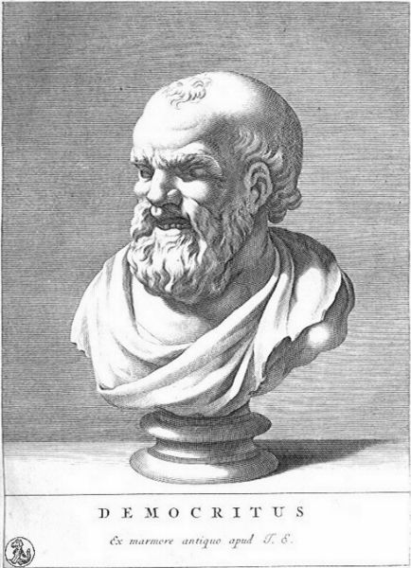
History of the Atom
Democritus (460-370 BC)
First person to come up with the thought of the atom (A – without, Tom – Cut)
He believed that there was a small object that couldn’t be cut anymore.

Slide 4
History of the Atom
Democritus’ Theory
Matter is made up of empty space through which atoms move.
There is an indestructible and indivisible particle called the atom.
Different atoms have different sizes and shapes.
Different properties are related to the size and shape of the atoms.

Slide 5
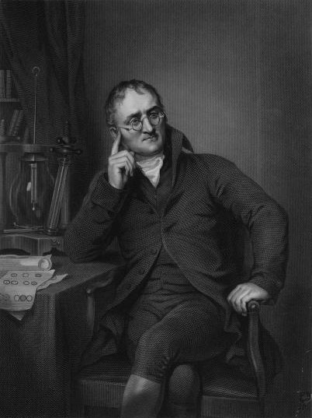
History of the Atom
John Dalton (1766 – 1844)
Revised Democritus’ theory of the atom making Dalton’s atomic theory.

Slide 6
History of the Atom
Dalton’s Theory
All matter is made of atoms.
All atoms of an element are the same. If it is a different element, the atoms are different.
Atoms can not be created or destroyed but can be combined, rearranged, or separated.
Form in simple whole number ratios.
Element 1
Element 2
Combine in whole number ratios

Slide 7
History of the Atom
Atom-
smallest particle of an element that still retains the properties of that element.

Slide 8
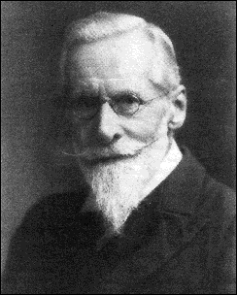
The History of Subatomic Particles
William Crookes –
Did work with a cathode ray tube.
Accidentally found that there were particles moving from the cathode to the anode of a tube causing it to flash.

Slide 9
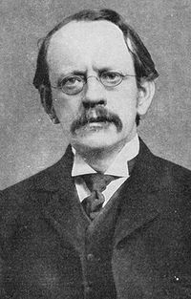
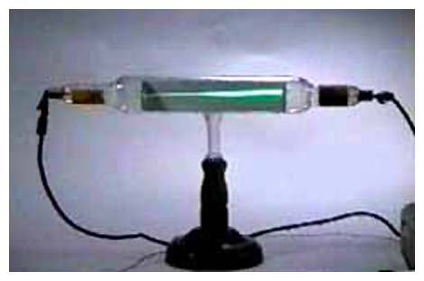
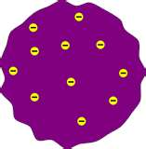
The History of Subatomic Particles
JJ Thomson – (1856- 1940)
Did experiments based upon charged and magnetic plates and its effect on the ray.
Based upon his work, JJ figured the mass to charge ratio, and it was smaller than Hydrogen, which meant that something smaller than atoms does occur. Discovered the electron.
Plum Pudding Model

Slide 10
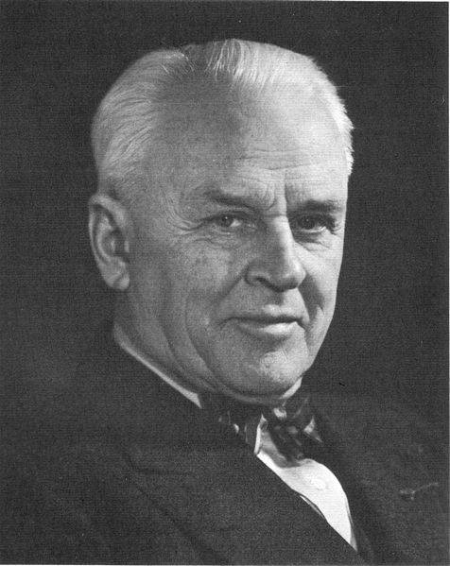
The History of Subatomic Particles
Robert Millikan – (1868 – 1909)
Determined the charge of the electron. Today we call it -1. He then used this to determine the mass of an electron was 9.1 x 10⁻²⁸ or 1/1840th mass of a hydrogen atom.
Oil drop experiment

Slide 11

The History of Subatomic Particles
Rutherford (1871- 1937)
Gold Foil experiment.
Fired alpha particles (protons) at a sheet of gold foil. Most passed straight through but a few bounced back.
He concluded that the atom was mostly empty space with a tiny dense region called the nucleus.

Slide 12
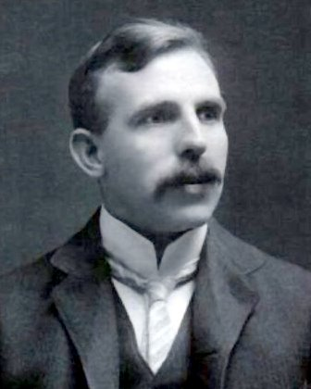
The History of the Subatomic Particle
Rutherford (1871- 1937)
Eight years after the gold foil experiment, he concluded that the nucleus contained positively charge particles or +1, called a proton.

Slide 13
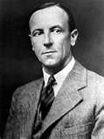
The History of Subatomic Particles
James Chadwick
Showed that the nucleus also contained a neutral particle called a neutron with about the same mass as a proton.

Slide 14
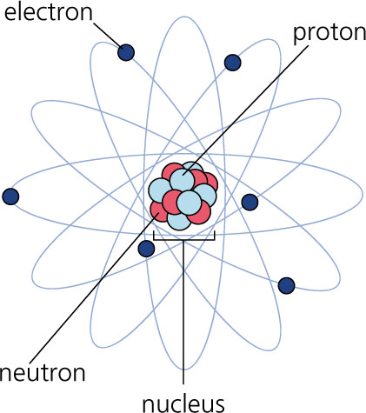
The History of Subatomic Particles
Niels Bohr & Bohr Model
Depicts the atom as a small, positively charged nucleus surrounded by electrons that travel in circular orbits around the nucleus—similar in structure to the solar system.

Slide 15
Structure of the Atom
Atomic Number – The number of protons in an atom. Number of protons = number of electrons
Mass Number = # protons + # Neutrons.
# of Neutrons = Mass number – protons
Atomic Mass – The average of all naturally occurring isotopes.

Slide 16
Structure of the Atom
Isotopes – Have the same number of protons but a different number of neutrons.
If an atom is an isotope you name it using the element name and then mass number
Writing Isotope Symbol

